Slide 1
Proposed new design (mobile style)

Slide 2
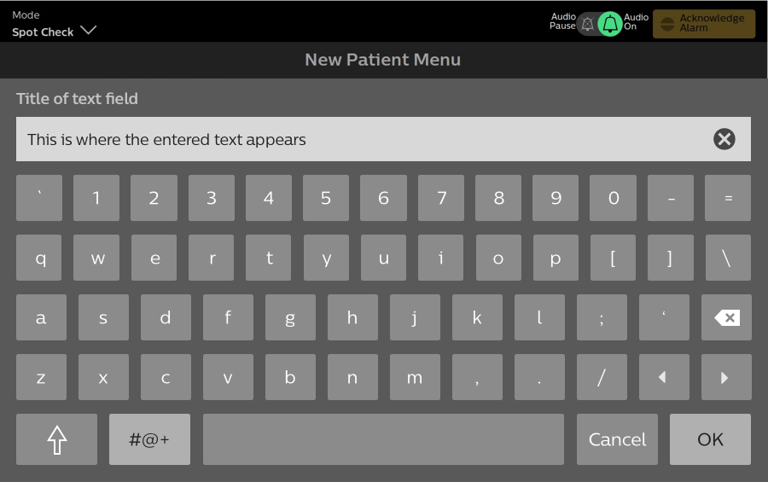
Keyboard refinements v3
Default Mode
Default keyboard
Single press up arrow to activate Shift for one character, keyboard reverts to default
Double press up arrow for Caps Lock
Press “#@+” for special characters

Slide 3
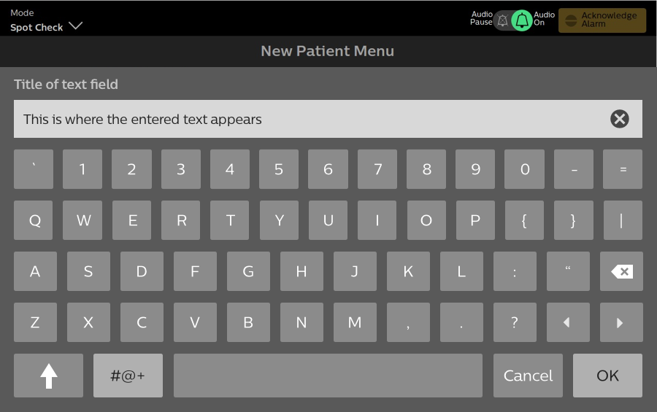
Keyboard refinements v3
Shift Mode
After character press, keyboard reverts to default
Double press up arrow for Caps Lock
Press “#@+” for special characters

Slide 4
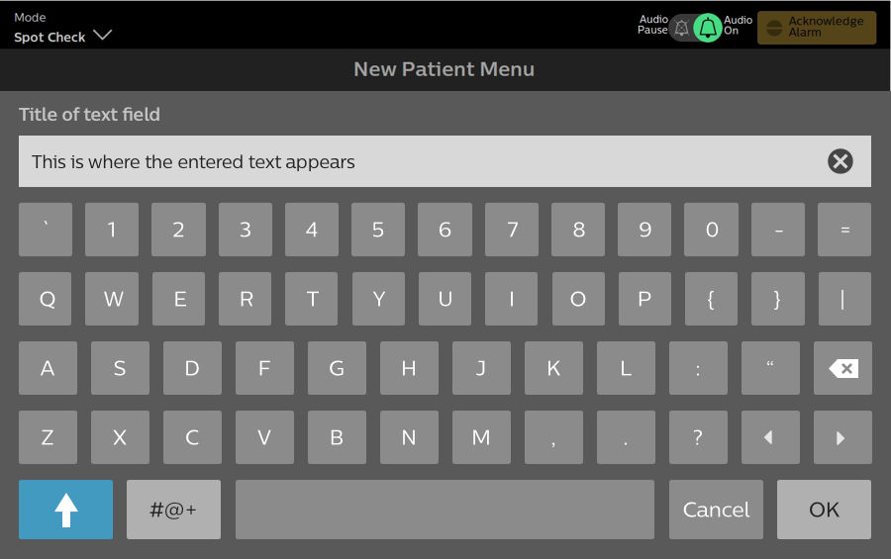
Keyboard refinements v3
Caps Lock Mode
Keyboard stays in Caps lock mode till blue up arrow key or “OK” is pressed
Single press up arrow to return to default keyboard
Press “#@+” for special characters

Slide 5
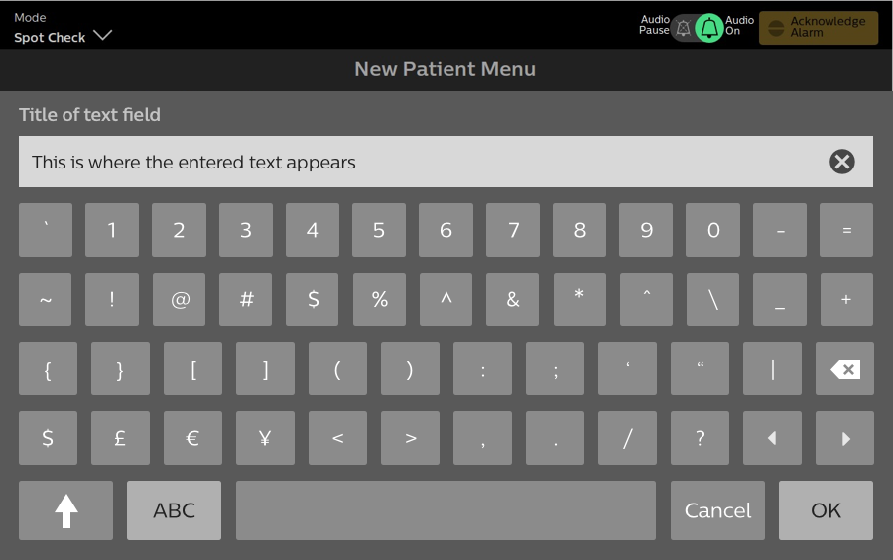
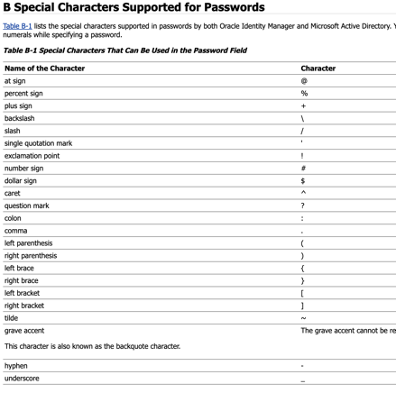
Keyboard refinements v3
Special Characters
Press ”ABC” to return to default keyboard
UNCH verbatim contractual requirement for September release reads as follows,
“AD integration to support all characters that Microsoft supports in their AD for passwords.”

Slide 6
Old design & Current R&D implementation

Slide 7

Keyboard refinements
Default status Keyboard
numerics + small letters
Cursor left right controls added
Default or Lock status 2/Shift status2
numerics+ small letters letters
Tracker #2 and #9

Slide 8
Keyboard refinements
Press shift for special characters and capital letters
Type any key and return to default numerics and small letters
Or Press shift again to return to default numerics and small letters
Shift status 1
specific symbols + capital letters
Tracker #2 and #9
Notes:
ic

Slide 9
Keyboard refinements
Press Lock for Locked capital letters
Press lock again to return to small letters
Lock status 1
numerics+ capital letters
Tracker #2 and #9

